Slide 1
Stewardship Forum Diocese of St. Augustine
Saturday, September 12
St. matthew Catholic Church
Jacksonville, Florida

Slide 2
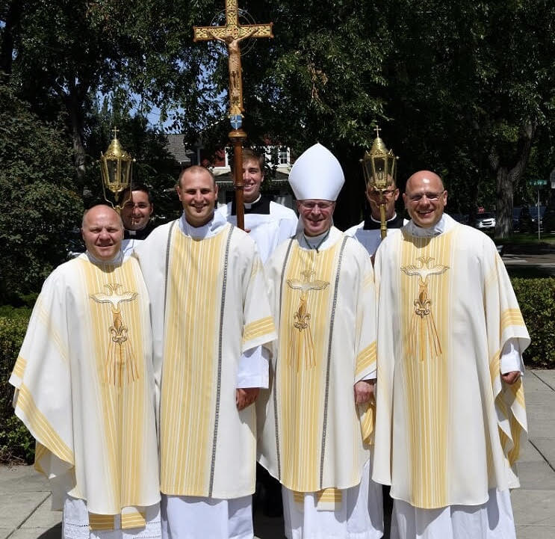
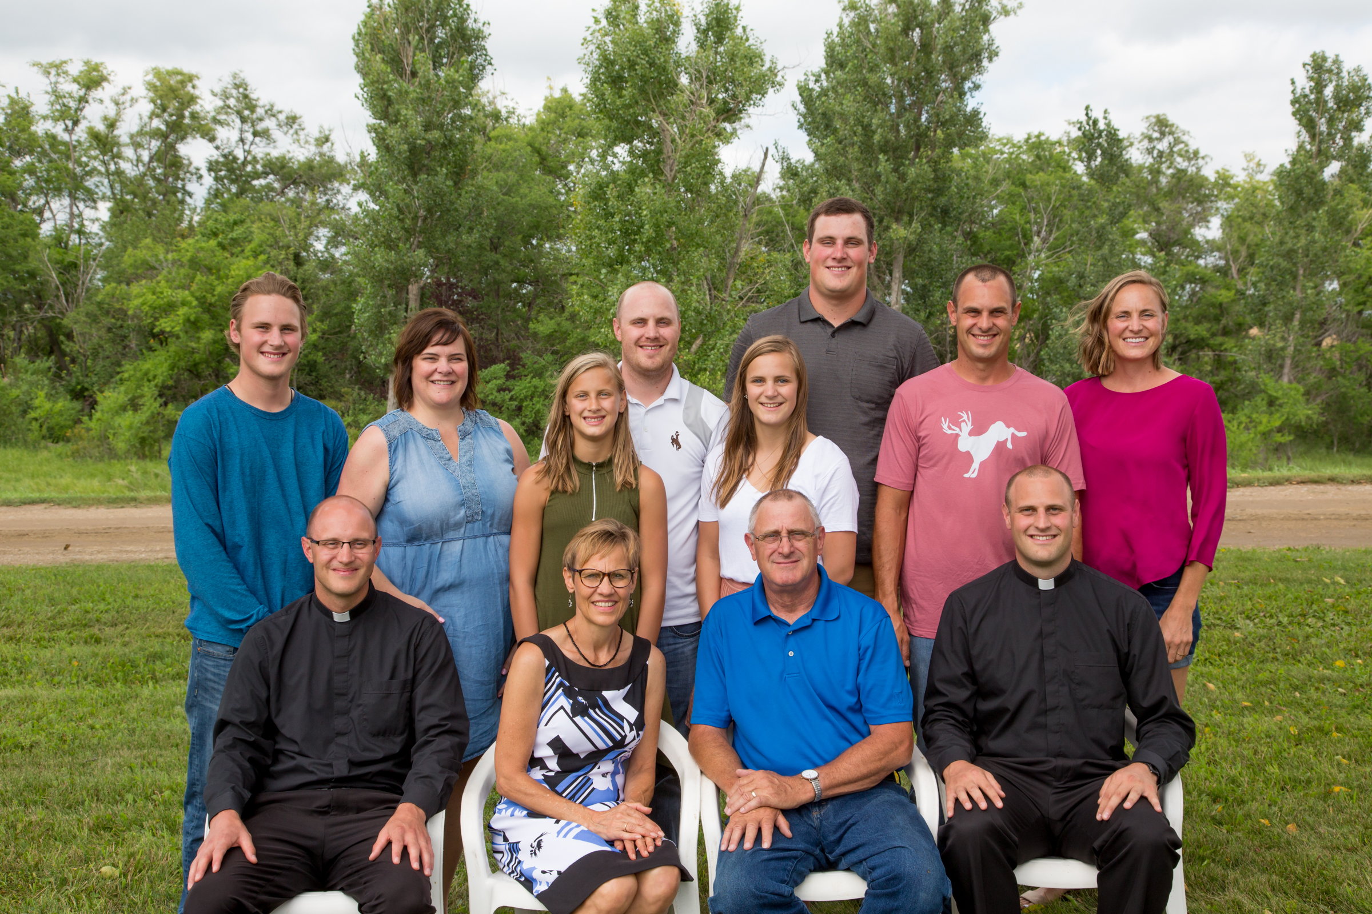
Diana Liska – About Me

Slide 3
Stewardship Steps
Step 1
Communication
Step 2
Hospitality
Step 3
Database
Step 4
Step 5
Step 6
Stewardship Committee
Ministry Life
Commitment Weekends

Slide 4
Step 1 Rally The Leadership Teams For A Unified Message
GOAL: For the staff and leadership groups to work together to help make disciples

Slide 5
Stewardship is the way of life
Staff informed and on board
Who is currently working on “Stewardship Tasks”
Existing Councils
Work together
Don’t duplicate work
Ongoing communication
Monthly or as-needed email to all leadership groups

Slide 6
Step 2 Infuse Hospitality Everywhere, Always, Forever
GOAL: For your parish to be a place of love and belonging for all members, guests and visitors

Slide 7
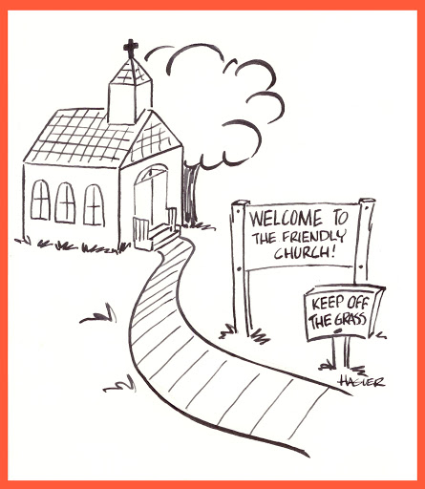
Website
Signage
Front desk/receptionist
New members
Greeters and ushers
Liturgy
Sacramental moments
Ministries/Ministry leaders

Slide 8
Hospitality Assessment
Followed by a small group discussion at your table
How has covid-19 impacted hospitality? Good? Bad?

Slide 9
Step 3 Clean Up Your Database
GOAL: Make informed decisions based on the true make-up of the parish family
Good Database
Stewardship Parish

Slide 10
Is your database up to date?
What to track?
Ministry involvement
Birthdays and anniversaries
Sacramental moments
Job/profession/talents
Notes, dinner invites, etc.
Consolidate forms
Create a plan to clean up parish roster
Daily/weekly process in place to keep database up to date

Slide 11
Step 4 Build A Rockstar Stewardship Committee
GOAL: To have a group of parishioners who continuously look at the parish through a Stewardship lens

Slide 12
Set up for success
Recruit stewards
Heart of prayer
Clear expectations
Defined mission and vision
Team structure
Planning a meeting
Have fun!
https://www.youtube.com/watch?v=0ZJ31v89X_Y

Slide 13
Large Group Discussion and Q&A
Covid-19 Blessings/Ideas:
Call-a-thon to all parishioners
Live streamed Mass for shut-ins and nursing homes
I spy faith alive – Daily social media challenge to engage parish community
Social distanced living rosary and root beer floats

Slide 14
Step 5 Breathe New Life Into The Parish Ministries
GOAL: To form lifelong disciples, not just volunteers helping a few hours after work
Evaluate current Ministries and Ministry Leaders
Ministry Leader training/gathering
Ministry Booklet
Ministry Fair

Slide 15
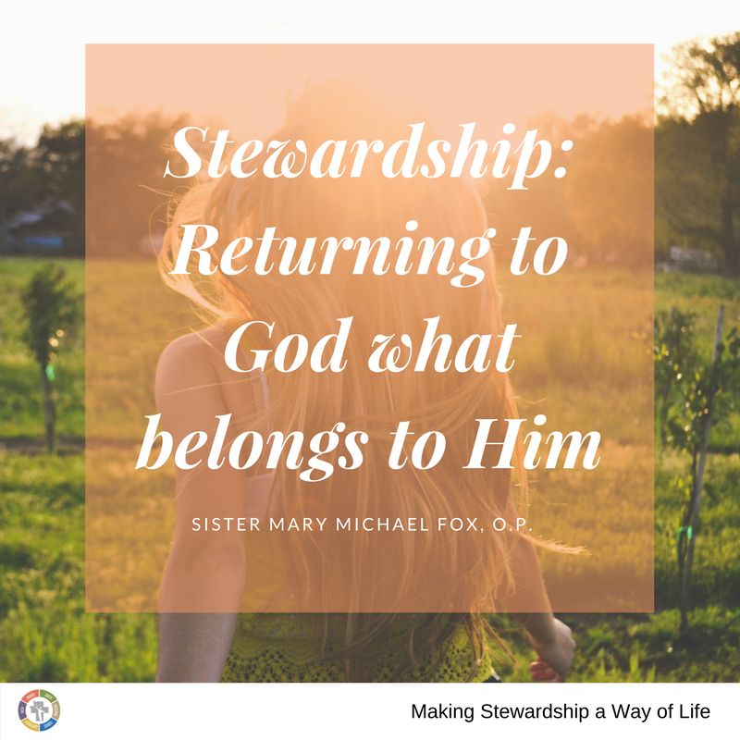
Step 6 Execute Stellar Commitment Weekends
GOAL: Provide an annual opportunity for your members to reflect on their giftedness and give back to God what is His

Slide 16
Before you begin
Don’t rush, the church is not going anywhere
Begin with the end in mind
Lay Witnesses properly trained
Altar Call during commitment weekends
Follow-up is vital

Slide 18
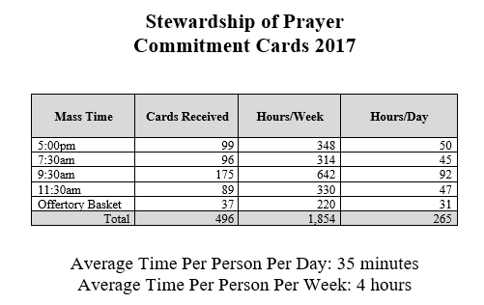
Time = Prayer

Slide 19
Talent
Ministry Fair same weekend
Attendees receive a one-pager of all the ministries and a booklet describing them when they arrive. The one pager gets turned in before they leave.
Each ministry holds an info session a few weeks after the fair
If you don’t like fairs, what other ways can you promote the ministries?
Sub-committee to oversee the planning and execution
What type of data do you want to collect? Very important!

Slide 20
Treasure
Annual Pledge
Why?
Benefits:
Give people an opportunity to re-evaluate their financial situation annually
Church budget
Make it clear where the money is going, always be transparent

Slide 21
Obstacles to Giving
They don’t have anything to give
Average credit card debt is $16K
4 credit cards
Pay $2K in interest per year
3 out of 4 people are in credit card debt
They don’t know how
They haven’t been asked
They haven’t been taught

Slide 22
Online giving must be an option

Slide 23
Stewardship is an expression of discipleship with the power to change how we understand and live out our lives.
Stewardship: A Disciple’s Response

Slide 24
What to do during Covid-19?
Build a killer website
Create or update your new member packet
Update ministry booklet
Update database
Plan and organize your first Ministry Leader gathering
Meet for one-on-one evaluations with Ministry Leaders (via Zoom if needed)
Make a Stewardship plan for the year
Work on branding for the Stewardship Committee - create logo, vision, etc.

Slide 25
My church is composed of people like me.
I help make it what it is.
It will be friendly, if I am.
Its pews will be filled, if I help fill them.
It will do great work, if I work.
It will make generous gifts to many causes, if I am a generous giver.
It will bring other people into its worship and fellowship, if I invite and bring them.
It will be a church of loyalty and love, of fearlessness and faith, and a church with a noble spirit, if I, who make it what it is, am filled with these same things.
Therefore, with the help of God, I shall dedicate myself to the task of being all the things that I want my church to be. Amen

Slide 26
Contact Information
Diana Liska
dianamarievetter@gmail.com
312-919-3764

